Slide 1
AC Circuits
The Circuit Elements in The Phasor Domain
By Dr. Ahmed S. Abdullah
د. احمد سليمان عبدالله

Slide 2
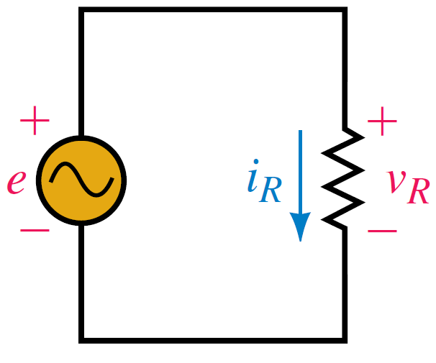
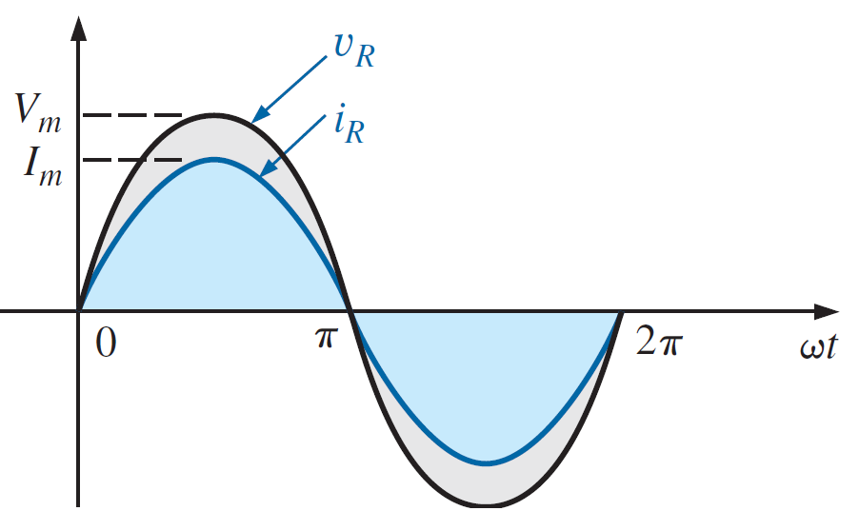
AC Through Pure Ohmic Resistor Alone
The voltage and current of a resistive element are in phase

Slide 3
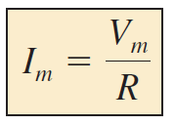
AC Through Pure Ohmic Resistor Alone

Slide 4
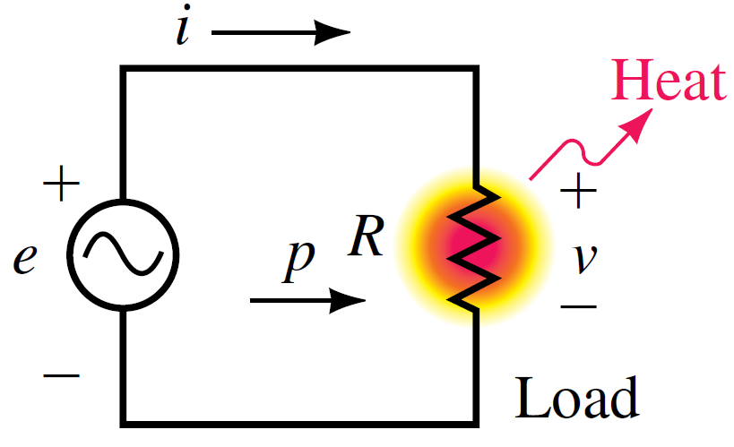
AC Through Pure Ohmic Resistor Alone
AVERAGE POWER AND POWER FACTOR
The instantaneous power (in watts) is the power at any instant of time.
$$v_{R}=V_{m}\sin{ωt}$$
$$i_{R}=I_{m}\sin{ωt}$$

Slide 5
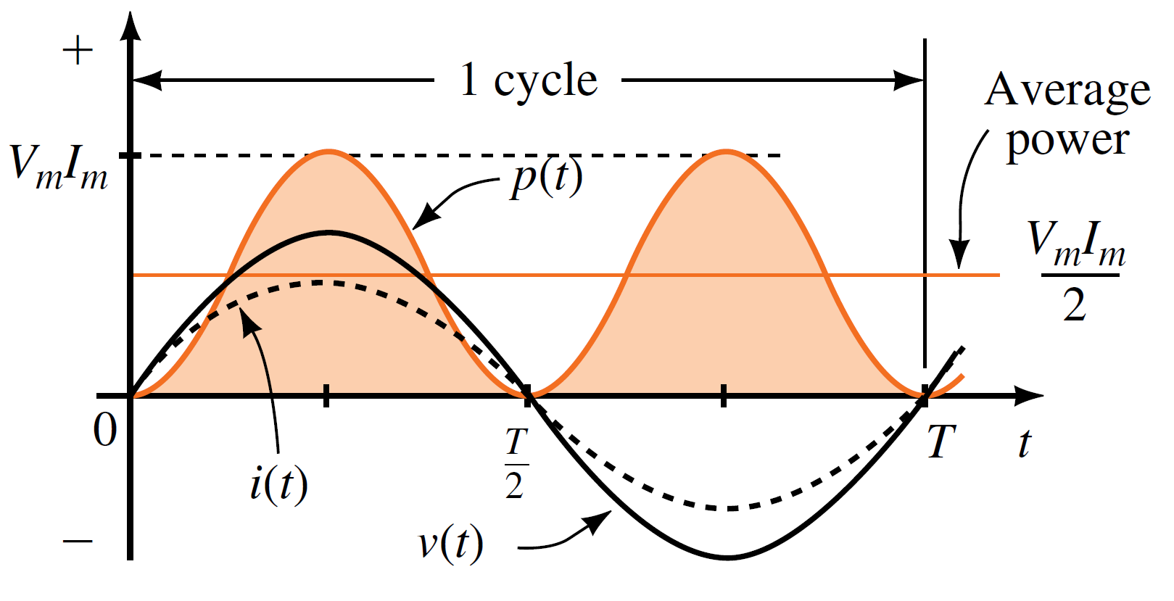
AC Through Pure Ohmic Resistor Alone
AVERAGE POWER AND POWER FACTOR
In a purely resistive circuit, since v and i are in phase, so that
Or since
Then

Slide 6
AC Through Pure Ohmic Resistor Alone
AVERAGE POWER AND POWER FACTOR
The power factor is the cosine of the phase difference between voltage and current. It is also the cosine of the angle of the load impedance.
Angle $θ$ is the angle between voltage and current. For a purely resistive load, the voltage and current are in phase, so that $θ=0^{o}$
$$F_{p}=\cos{θ}=\cos{0^{o}=1}$$

Slide 7
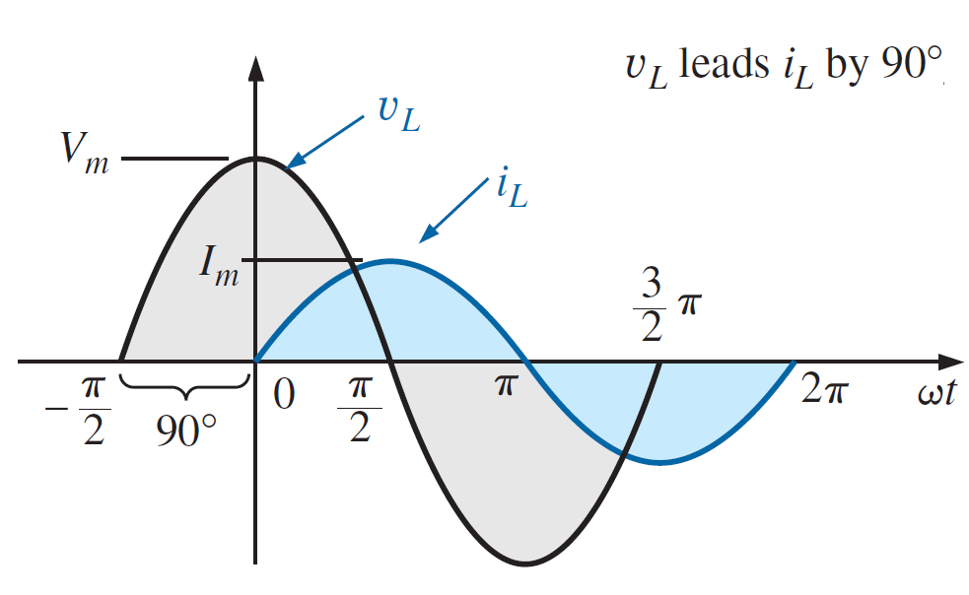
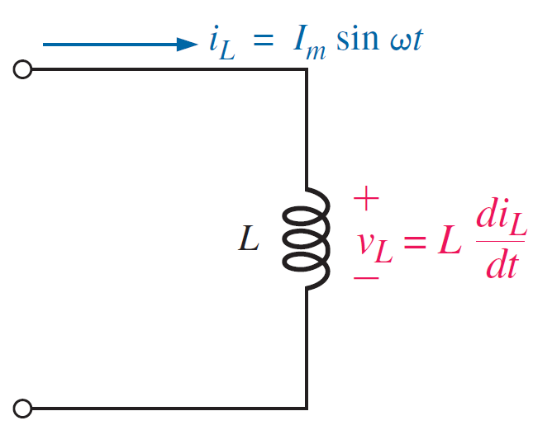
AC Through Pure Inductance Alone
For an inductor, V_{L} leads i_{L} by 90°, or i_{L} lags V_{L} by 90°.

Slide 8
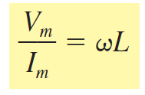
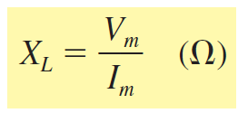
AC Through Pure Inductance Alone
$$i_{L}=I_{m}\sin{ωt}$$
This ratio is defined as Inductive Reactance and is given the symbol X_{L}
$$X_{L}=2πfL (Ω)$$

Slide 9
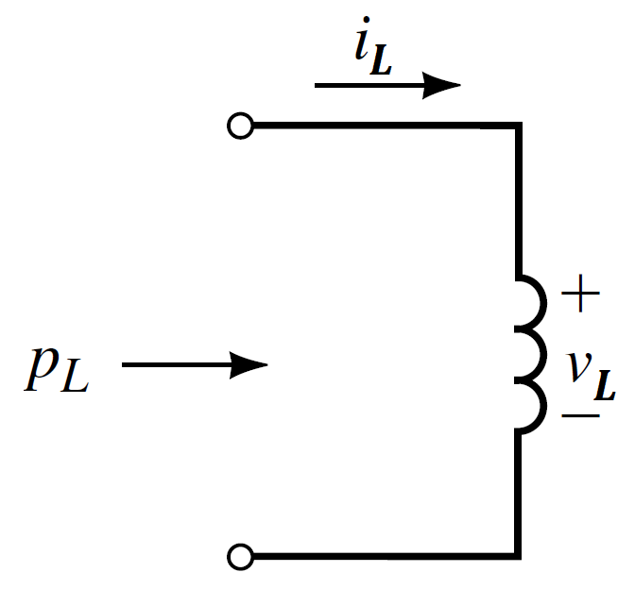
AC Through Pure Inductance Alone
AVERAGE POWER AND POWER FACTOR
For a purely inductive load, current lags voltage by 90°.
$$v_{L}=V_{m}\sin{(ωt+{90}^{o})}$$
$$i_{L}=I_{m}\sin{ωt}$$

Slide 10
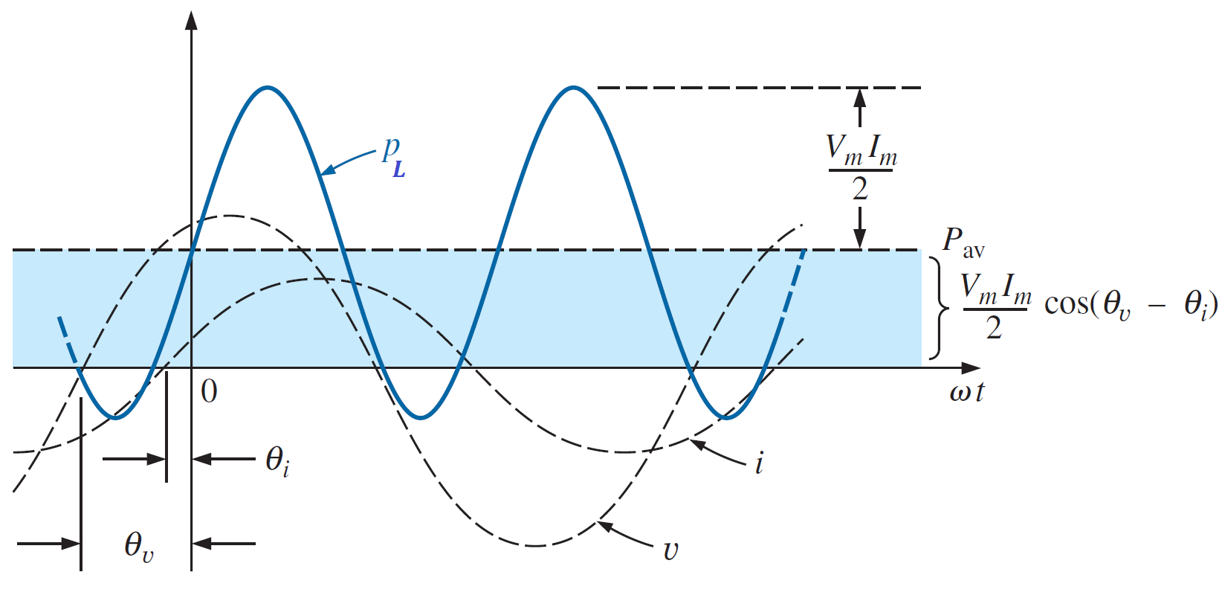
AC Through Pure Inductance Alone
AVERAGE POWER AND POWER FACTOR
For a purely inductive load, current lags voltage by 90°.
$$v_{L}=V_{m}\sin{(ωt+{90}^{o})}$$
$$i_{L}=I_{m}\sin{ωt}$$
After some trigonometric manipulation,
this reduces to
$$P_{L}=\frac{V_{m}I_{m}}{2} cos θ$$

Slide 11
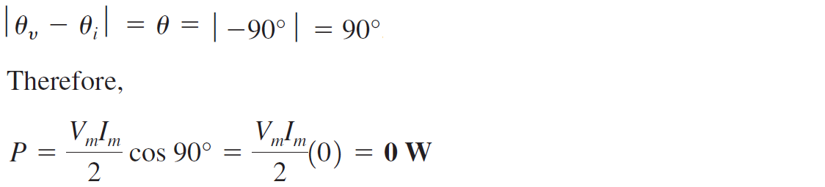
AC Through Pure Inductance Alone
AVERAGE POWER AND POWER FACTOR
For a purely inductive load, current lags voltage by 90°.
$$P_{L}=\frac{V_{m}I_{m}}{2} cos θ$$
The average power or power dissipated by the ideal inductor
(no associated resistance) is zero watts.

Slide 12
AC Through Pure Inductance Alone
AVERAGE POWER AND POWER FACTOR
The power factor is the cosine of the phase difference between voltage and current. It is also the cosine of the angle of the load impedance.
Angle $θ$ is the angle between voltage and current. For a purely inductive load, current lags voltage by 90°, so that $θ={90}^{o}$
$$F_{p}=\cos{θ}=\cos{{90}^{o}=0}$$

Slide 13
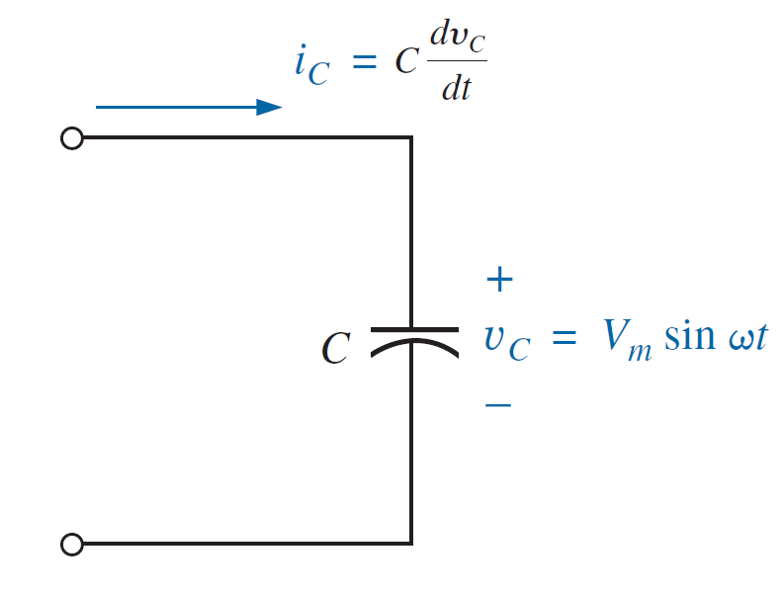
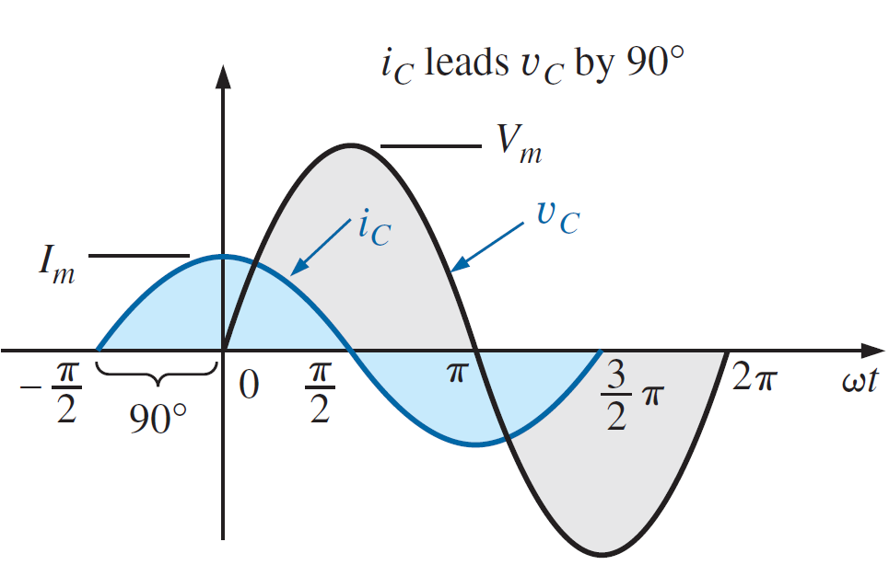
AC Through Pure Capacitor Alone
For an capacitor, i_{C} leads V_{C} by 90°, or V_{C} lags i_{C} by 90°.

Slide 14
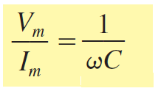
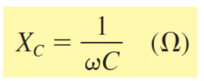
AC Through Pure Capacitor Alone
$$v_{C}=V_{m}\sin{ωt}$$
This ratio is defined as Capacitive Reactance and is given the symbol X_{C}
$$X_{C}=\frac{1}{2πfC} (Ω)$$

Slide 15
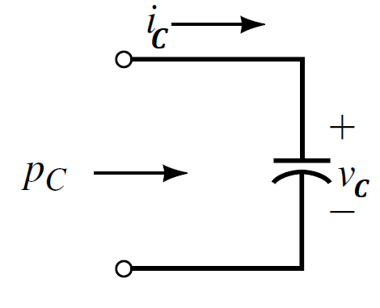
AC Through Pure Capacitor Alone
AVERAGE POWER AND POWER FACTOR
For a purely Capacitive load, current leads voltage by 90°.
$$i_{C}=I_{m}\sin{(ωt+{90}^{o})}$$
$$v_{C}=V_{m}\sin{ωt}$$

Slide 16
AC Through Pure Capacitor Alone
AVERAGE POWER AND POWER FACTOR
For a purely Capacitive load, current leads voltage by 90°.
$$i_{C}=I_{m}\sin{(ωt+{90}^{o})}$$
$$v_{C}=V_{m}\sin{ωt}$$
After some trigonometric manipulation,
this reduces to
$$P_{C}=\frac{V_{m}I_{m}}{2} cos θ$$

Slide 17
AC Through Pure Capacitor Alone
AVERAGE POWER AND POWER FACTOR
For a purely Capacitive load, current leads voltage by 90°.
$$P_{C}=\frac{V_{m}I_{m}}{2} cos θ$$
The average power or power dissipated by the ideal capacitor (no associated resistance) is zero watts.

Slide 18
AC Through Pure Capacitor Alone
AVERAGE POWER AND POWER FACTOR
The power factor is the cosine of the phase difference between voltage and current. It is also the cosine of the angle of the load impedance.
Angle $θ$ is the angle between voltage and current. For a purely Capacitive load, current leads voltage by 90°, so that $θ={90}^{o}$
$$F_{p}=\cos{θ}=\cos{{90}^{o}=0}$$

Slide 19
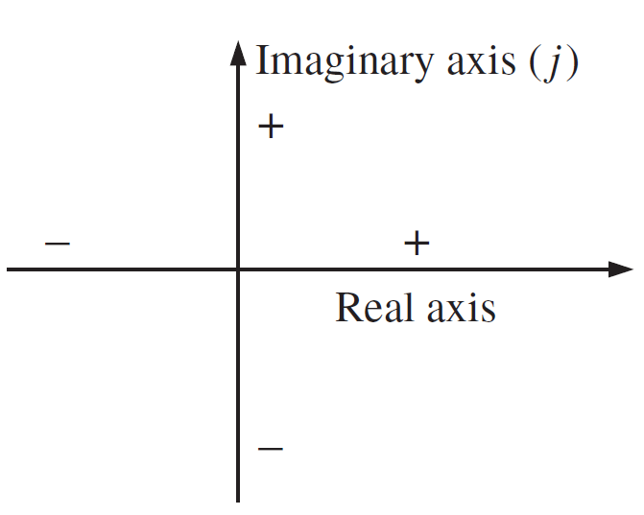
Complex Numbers
A complex number represents a point in a two-dimensional plane located with reference to two distinct axes. This point can also determine a radius vector drawn from the origin to the point. The horizontal axis is called the real axis, while the vertical axis is called the imaginary axis.

Slide 20
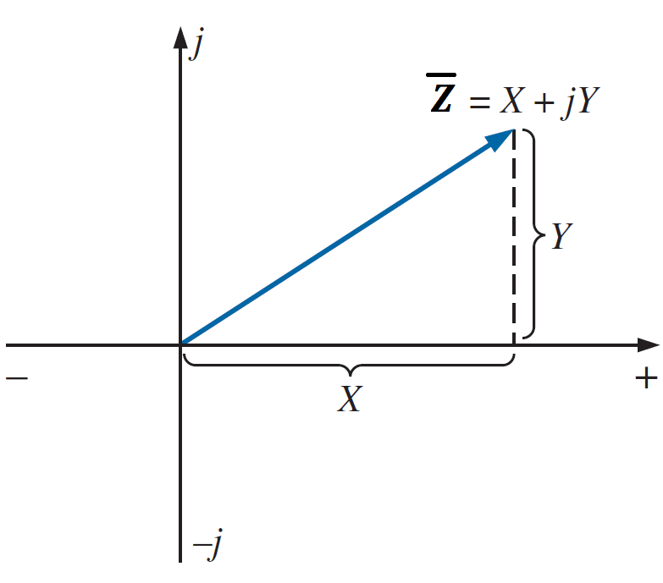
Complex Numbers
Rectangular Form
The format for the rectangular form is
Where
$\overline{Z}$ is the complex number
X is the real part of Z (Re(Z))
Y is the imaginary part of Z (Im(Z))
j $= \sqrt{−1}$

Slide 21
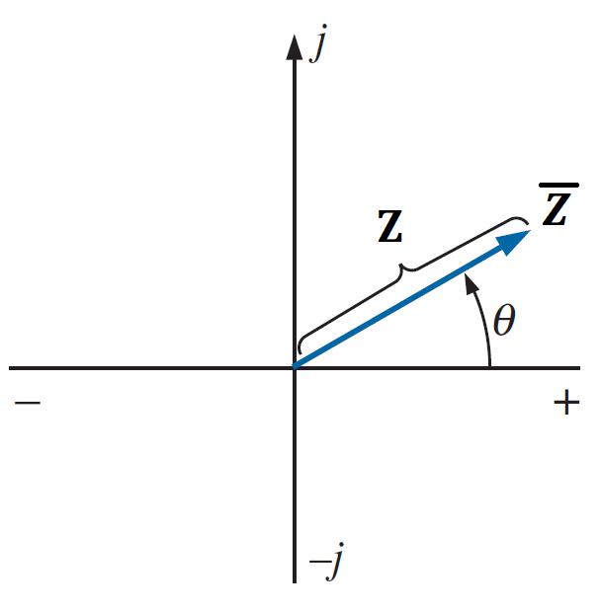
Complex Numbers
Polar Form
The format for the Polar form is
Where
Z is the magnitude of $\overline{Z}$
$θ$ is the angle of $\overline{Z}$ with the real axis

Slide 22
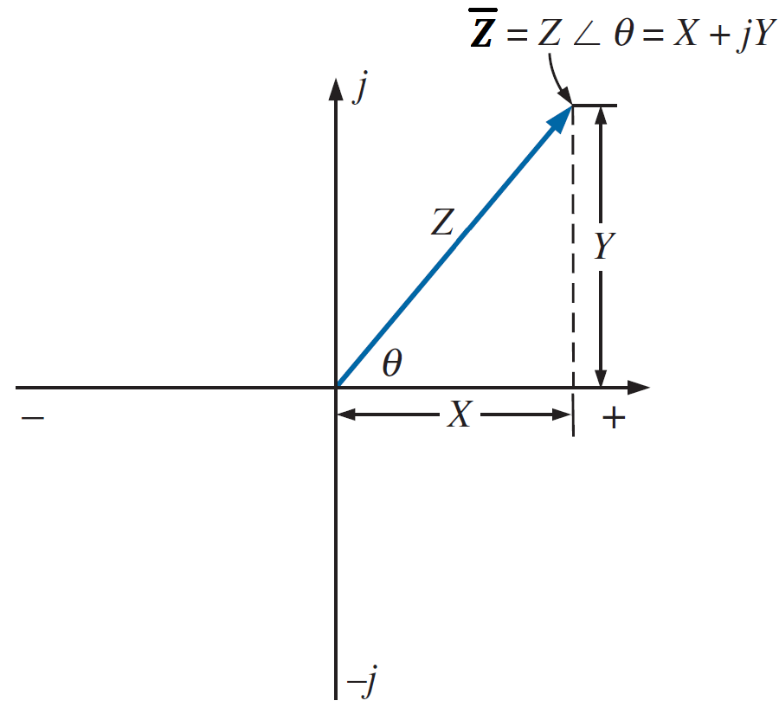
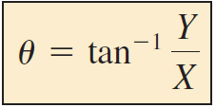
Complex Numbers
Conversion Between Forms
Rectangular to Polar

Slide 23
Complex Numbers
Conversion Between Forms
Rectangular to Polar
EXAMPLE : Convert the following from rectangular to polar form:
$$\overline{Z}=3+j4$$
$$Z=\sqrt{3^{2}+4^{2}}=\sqrt{25}=5$$
$$θ=\tan^{−1}\frac{4}{3}={53.13}^{o}$$
$\overline{Z}=Z ∠θ=5 ∠$ ${53.13}^{o}$

Slide 24
Complex Numbers
Conversion Between Forms
Polar to Rectangular

Slide 25
Complex Numbers
Conversion Between Forms
Polar to Rectangular
EXAMPLE : Convert the following from polar to rectangular form:
$\overline{Z_{1}}=5 ∠$ ${53.13}^{o}$
$$X=5 cos{ (53.13}^{o})=3$$
$$Y=5 sin{ (53.13}^{o})=4$$
$$\overline{Z}=X+jY=3+j4$$

Slide 26
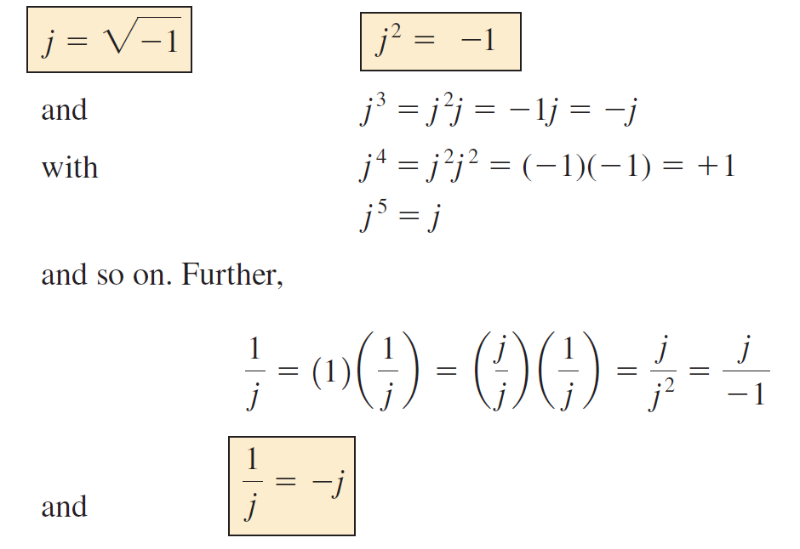
Complex Numbers
Mathematical Operations With Complex Numbers

Slide 27
Complex Numbers
Mathematical Operations With Complex Numbers
Addition and Subtraction
$$Z_{1}=X_{1}+jY_{1}$$
$$Z_{2}=X_{2}+jY_{2}$$
$$Z_{1}+Z_{2}=\left(X_{1}+X_{2}\right)+j(Y_{1}+Y_{2})$$
$$Z_{1}−Z_{2}=\left(X_{1}−X_{2}\right)+j(Y_{1}−Y_{2})$$

Slide 28
Complex Numbers
Mathematical Operations With Complex Numbers
Addition and Subtraction
$$Z_{1}=2+j4$$
$$Z_{2}=3+j1$$
$$Z_{1}+Z_{2}=\left(2+3\right)+j\left(4+1\right)=5+j5$$
$$Z_{1}−Z_{2}=\left(2−3\right)+j\left(4−1\right)=−1+j3$$

Slide 29
Complex Numbers
Mathematical Operations With Complex Numbers
Addition and Subtraction
Addition or subtraction cannot be performed in polar form unless the complex numbers have the same angle $θ$ or unless they differ only by multiples of 180°.
$$Z_{1}=2 ∠{45}^{o}$$
$$Z_{2}=3 ∠{45}^{o}$$
$$Z_{1}+Z_{2}=5 ∠{45}^{o}$$

Slide 30
Complex Numbers
Mathematical Operations With Complex Numbers
Multiplication
Rectangular
$$Z_{1}=X_{1}+jY_{1}$$
$$Z_{2}=X_{2}+jY_{2}$$
$Z_{1}$. $Z_{2}=(X_{1}+jY_{1})(X_{2}+jY_{2})$
$Z_{1}$. $Z_{2}=X_{1}X_{2}+jX_{1}Y_{2}$+${jY_{1}X}_{2}−{Y_{1}Y}_{2}$
$Z_{1}$. $Z_{2}={(X}_{1}X_{2}−{Y_{1}Y}_{2})+j(X_{1}Y_{2}$+${Y_{1}X}_{2})$

Slide 31
Complex Numbers
Mathematical Operations With Complex Numbers
Multiplication
Rectangular
$$Z_{1}=2+j3$$
$$Z_{2}=5+j10$$
$Z_{1}$. $Z_{2}=(2+j3)(5+j10)$
$Z_{1}$. $Z_{2}=(2)(5)+j(2)(10)+j(3)(5)−(3)(10)$
$Z_{1}$. $Z_{2}=(10−30)+j(20+15)$
$$=−20+j35$$

Slide 32
Complex Numbers
Mathematical Operations With Complex Numbers
Multiplication
Polar
$$\overline{Z_{1}}=Z_{1} ∠θ_{1}$$
$$\overline{Z_{2}}=Z_{2} ∠θ_{2}$$
$\overline{Z_{1}}$. $\overline{Z_{2}}=Z_{1}Z_{2 }∠θ_{1}$+ $θ_{2}$

Slide 33
Complex Numbers
Mathematical Operations With Complex Numbers
Multiplication
Polar
$$\overline{Z_{1}}=5 ∠{20}^{o}$$
$$\overline{Z_{2}}=10 ∠{30}^{o}$$
$\overline{Z_{1}}$. $\overline{Z_{2}}=Z_{1}Z_{2 }∠θ_{1}$+ $θ_{2}$
$Z_{1}$. $Z_{2}=(5) (10)∠{20}^{o}$+${30}^{o}$
$Z_{1}$. $Z_{2}=50∠{50}^{o}$

Slide 34
Complex Numbers
Mathematical Operations With Complex Numbers
Division
Rectangular
$$Z_{1}=X_{1}+jY_{1}$$
$$Z_{2}=X_{2}+jY_{2}$$
$$\frac{Z_{1}}{Z_{2}}=\frac{X_{1}+jY_{1}}{X_{2}+jY_{2}}$$
We rationalize the denominator by multiplying both the numerator and denominator by ${Z_{2}}^{∗}$
$${Z_{2}}^{∗}=X_{2}−jY_{2}$$

Slide 35
Complex Numbers
Mathematical Operations With Complex Numbers
Division
Rectangular
$$Z_{1}=X_{1}+jY_{1}$$
$$Z_{2}=X_{2}+jY_{2}$$
$$\frac{Z_{1}}{Z_{2}}=\frac{X_{1}+jY_{1}}{X_{2}+jY_{2}}×\frac{X_{2}−jY_{2}}{X_{2}−jY_{2}}$$
$$\frac{Z_{1}}{Z_{2}}=$$

Slide 36
Complex Numbers
Mathematical Operations With Complex Numbers
Division
Rectangular
$$Z_{1}=1+j4$$
$$Z_{2}=4+j5$$

Slide 37
Complex Numbers
Mathematical Operations With Complex Numbers
Division
Rectangular
$$Z_{1}=1+j4$$
$$Z_{2}=4+j5$$
$$\frac{Z_{1}}{Z_{2}}=\frac{1+j4}{4+j5}×\frac{4−j5}{4−j5}$$

Slide 38
Complex Numbers
Mathematical Operations With Complex Numbers
Division
Rectangular
$$Z_{1}=1+j4$$
$$Z_{2}=4+j5$$
$$\frac{Z_{1}}{Z_{2}}=\frac{1+j4}{4+j5}×\frac{4−j5}{4−j5}$$
$$\frac{Z_{1}}{Z_{2}}=\frac{\left(1\right)\left(4\right)+(4)(5)}{4^{2}+5^{2}}+j\frac{(4)(4)−(1)(5)}{4^{2}+5^{2}}$$

Slide 39
Complex Numbers
Mathematical Operations With Complex Numbers
Division
Rectangular
$$Z_{1}=1+j4$$
$$Z_{2}=4+j5$$
$$\frac{Z_{1}}{Z_{2}}=\frac{\left(4\right)+(20)}{16+25}+j\frac{(16)−(5)}{16+25}$$

Slide 40
Complex Numbers
Mathematical Operations With Complex Numbers
Division
Rectangular
$$Z_{1}=1+j4$$
$$Z_{2}=4+j5$$
$$\frac{Z_{1}}{Z_{2}}=\frac{24}{41}+j\frac{11}{41}≅0.59+j0.27$$

Slide 41
Complex Numbers
Mathematical Operations With Complex Numbers
Division
Polar
$$\overline{Z_{1}}=Z_{1} ∠θ_{1}$$
$$\overline{Z_{2}}=Z_{2} ∠θ_{2}$$
$\frac{\overline{Z_{1}}}{\overline{Z_{2}}}=\frac{Z_{1}}{Z_{2}}∠θ_{1}−$ $θ_{2}$

Slide 42
Complex Numbers
Mathematical Operations With Complex Numbers
Division
Polar
$$\overline{Z_{1}}=15 ∠{10}^{o}$$
$$\overline{Z_{2}}=2 ∠7^{o}$$
$\frac{\overline{Z_{1}}}{\overline{Z_{2}}}=\frac{Z_{1}}{Z_{2}}∠θ_{1}−$ $θ_{2}$
$$\frac{\overline{Z_{1}}}{\overline{Z_{2}}}=\frac{15}{2}∠{10}^{o}−7^{o}=7.5∠ 3^{o}$$

Slide 43
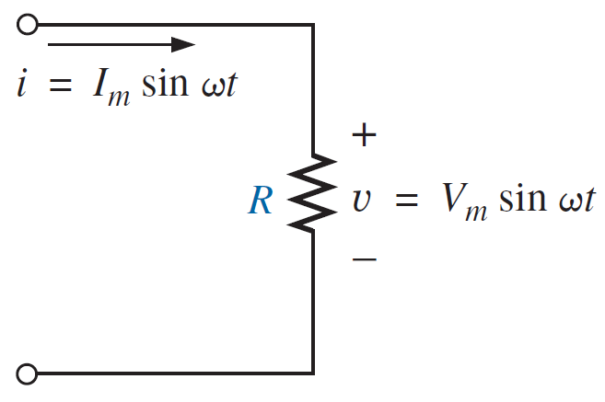
IMPEDANCE
Resistive Elements
The voltage and current of a resistive element are in phase
Applying Ohm’s law and using phasor algebra, we have

Slide 44
IMPEDANCE
Resistive Elements
The voltage and current of a resistive element are in phase
The quantity Z_{R} , having both magnitude and an associated angle, is referred to as the impedance of a resistive element.

Slide 45
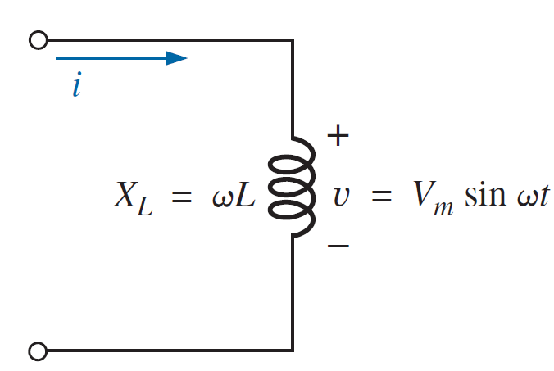
IMPEDANCE
Inductive Reactance
For a purely inductive load, voltage leads current by 90°.

Slide 46
IMPEDANCE
Inductive Reactance
For a purely inductive load, voltage leads current by 90°.
$$Z_{L}=$$
The quantity Z_{L} , having both magnitude and an associated angle, is referred to as the impedance of a inductive element.

Slide 47
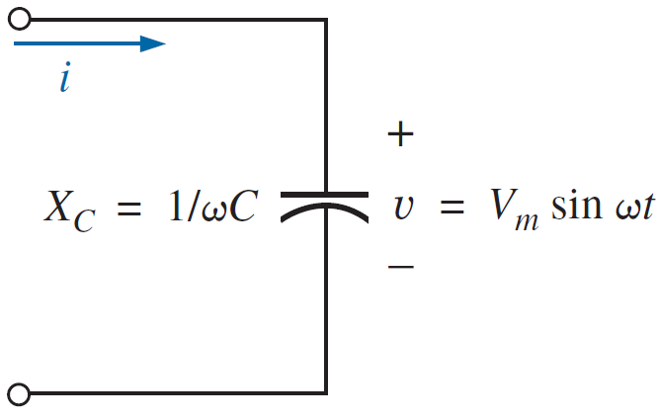
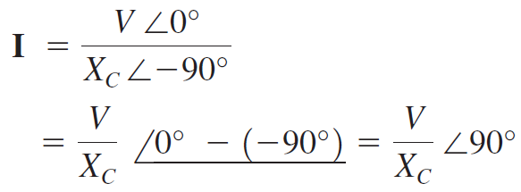
IMPEDANCE
Capacitive Reactance
For a purely capacitive load, current leads voltage by 90°.

Slide 48
IMPEDANCE
Capacitive Reactance
For a purely capacitive load, current leads voltage by 90°.
$$Z_{C}=$$
The quantity Z_{C} , having both magnitude and an associated angle, is referred to as the impedance of a capacitive element.

Slide 49
Summary of parameters for R, L , and C
 | R | L | C
Phase difference $$∅$$ | 0 $v and i in phase$ | 90º $v_{L}$ leads $i_{L}$ or $i_{L}$ lags $v_{L}$ | 90º $v_{C}$ lags $i_{C}$ or $i_{C}$ leads $v_{C}$
Reactance | $$R$$ | $$X_{L}=ωL$$ | $$X_{C}=\frac{1}{ωC}$$
Average power $$P_{av}$$ | $$\frac{V_{m}I_{m}}{2}= V_{rms}I_{rms}$$ | 0 | 0
Power factor $\cos{θ}$ | 1 | 0 | 0
impedance
Element
Parameter

Slide 50
References
Boylestad, Robert L. Introductory circuit analysis. Pearson Education, 2010.
Robbins, Allan H., and Wilhelm C. Miller. Circuit analysis: Theory and practice. Cengage Learning, 2012.
Sadiku, Matthew NO, and Chales K. Alexander. Fundamentals of electric circuits. McGraw-Hill Higher Education, 2007.

